Slide 1
Build your own copilot with Microsoft Copilot Studio
[Name]

Slide 2











Microsoft Power Platform
Power Apps
Application development
Power Automate
Process automation
Power BI
Business analytics
Copilot Studio
Intelligent copilots
Power Pages
External websites
With new building canvas and GPT
Data connectors
AI Builder
Microsoft Dataverse
Power Fx
Managed
Environments

Slide 3














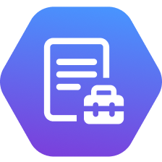
Copilots and Conversational AI
Build and extend across the Microsoft ecosystem
Custom copilots
Microsoft 365
Biz Apps & Power Platform
Other Microsoft Copilots
Build Custom copilots and bots for enterprises and third parties
Extend Microsoft 365 Copilot
Extend Copilot experiences in Dynamics 365 and Power Products
Extend other Microsoft Copilot Experiences
Copilot for Sales
Copilot for Service
Power Platform
Microsoft Copilot Studio Build custom Copilots | Extend and customize 1st party copilots

Slide 4
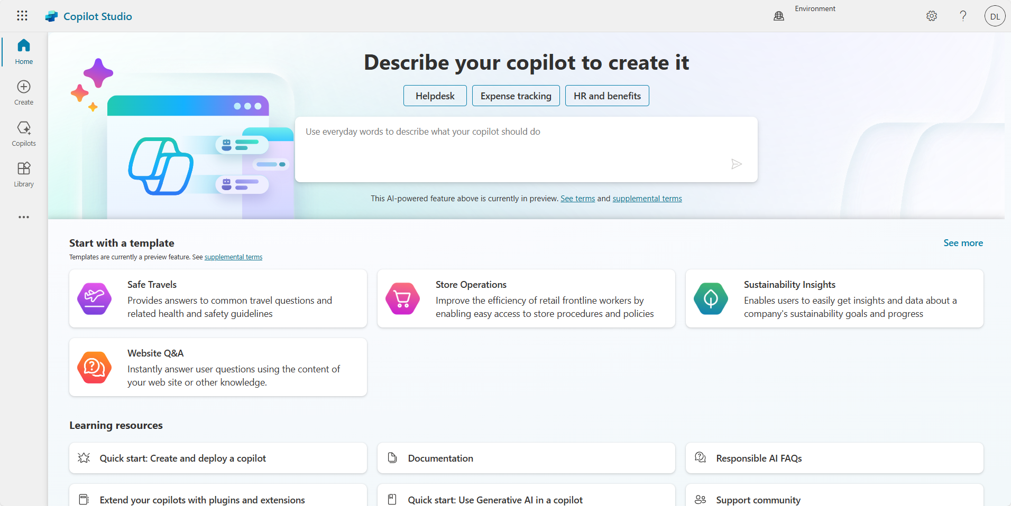
Microsoft Copilot Studio
Build your own copilot
Create and publish a custom copilot for your organization using the intuitive building experience enhanced with large language models and Generative AI
Extend Microsoft Copilot Extend and customize 1st party Microsoft Copilots with your own enterprise scenarios with your own enterprise scenarios
Available with Microsoft Copilot
Copilot Studio will be included with the Microsoft 365 Copilot SKU.
Connected platform
Integrates and exposes various Microsoft’s conversational AI technology stacks - integrated with Azure AI Studio, Azure Cognitive Services, Azure Bot Framework, Power Platforms AI models and more

Slide 5
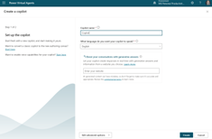
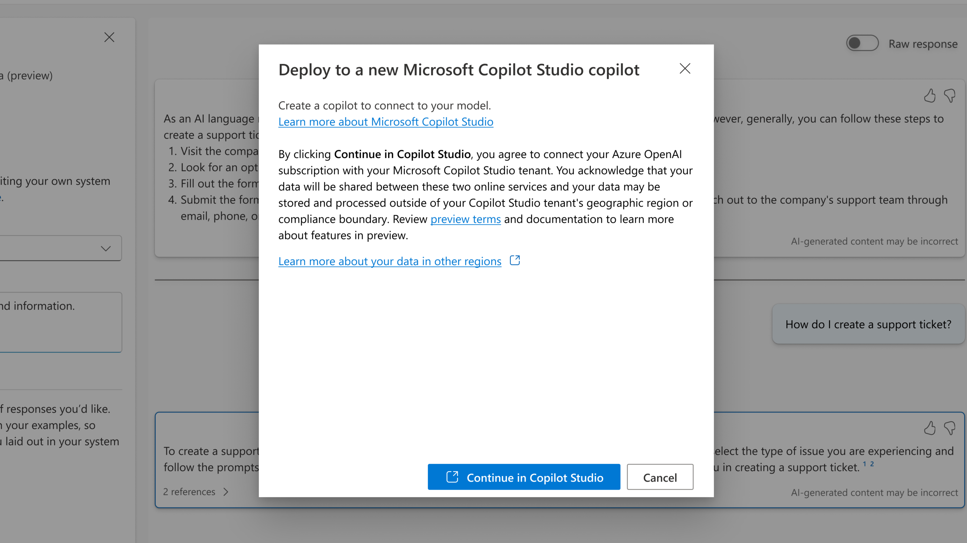
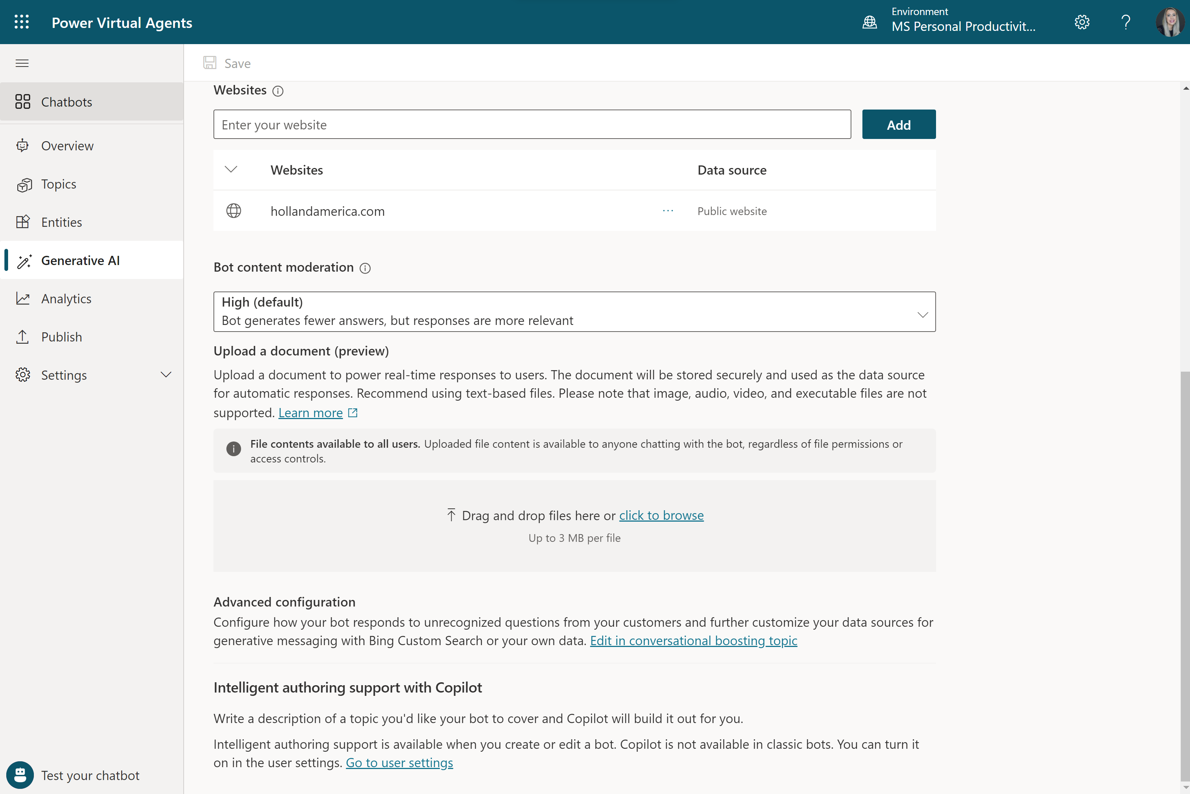
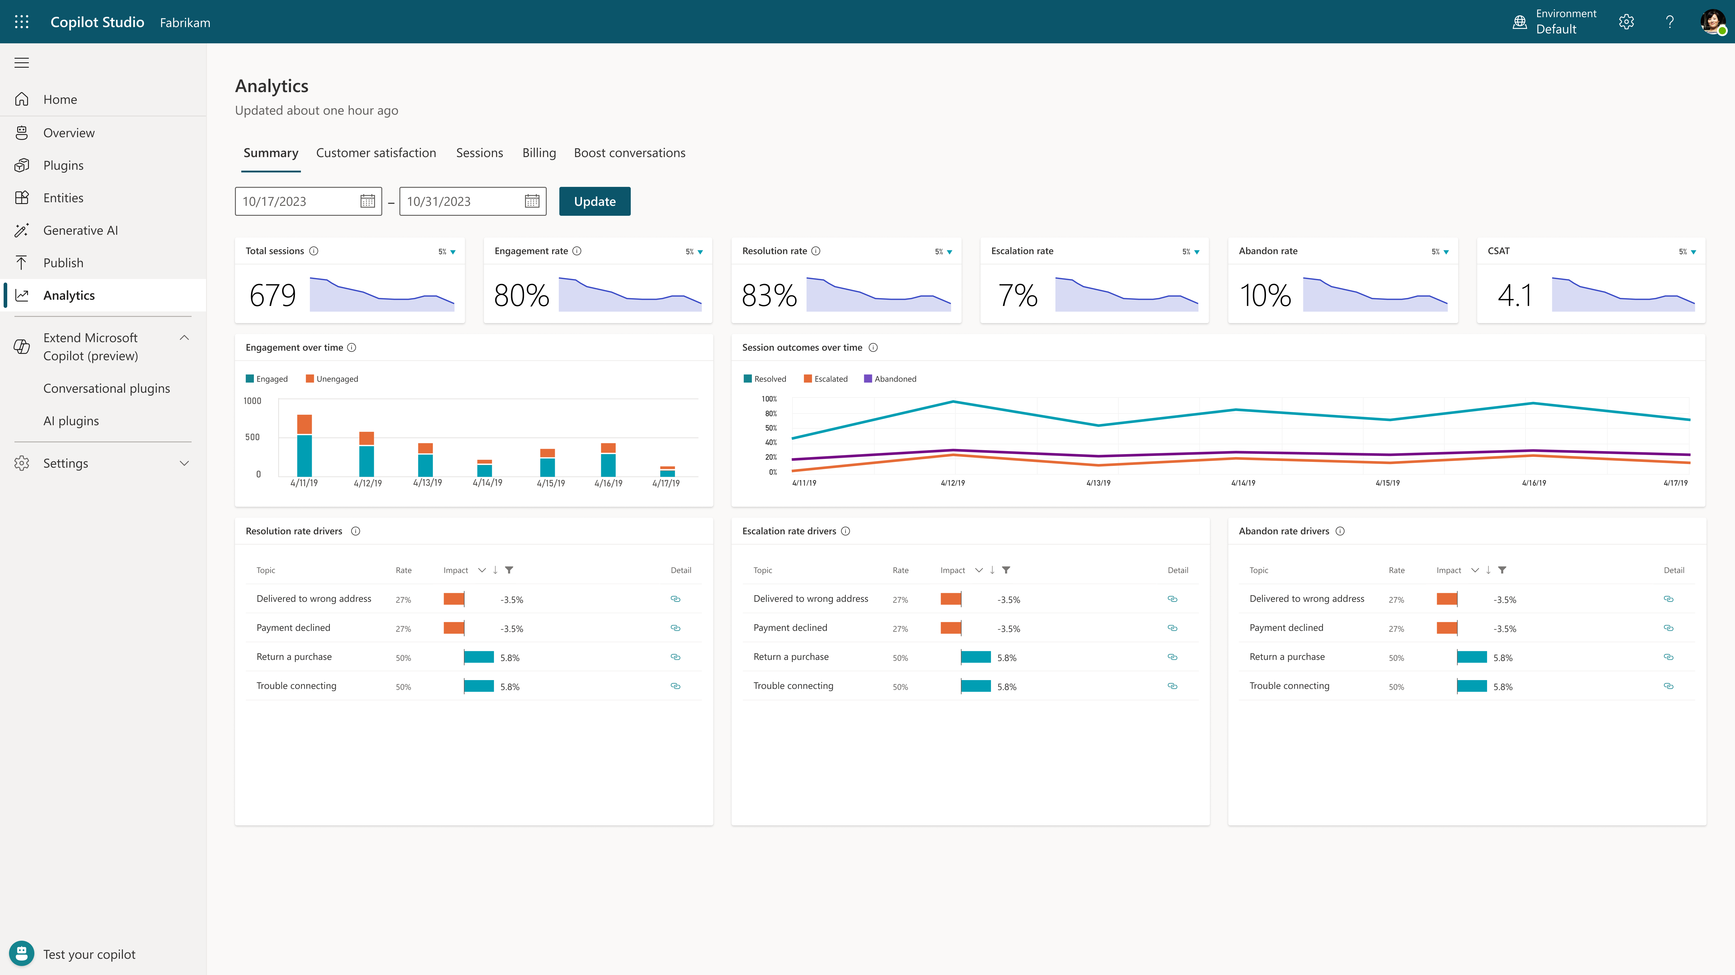
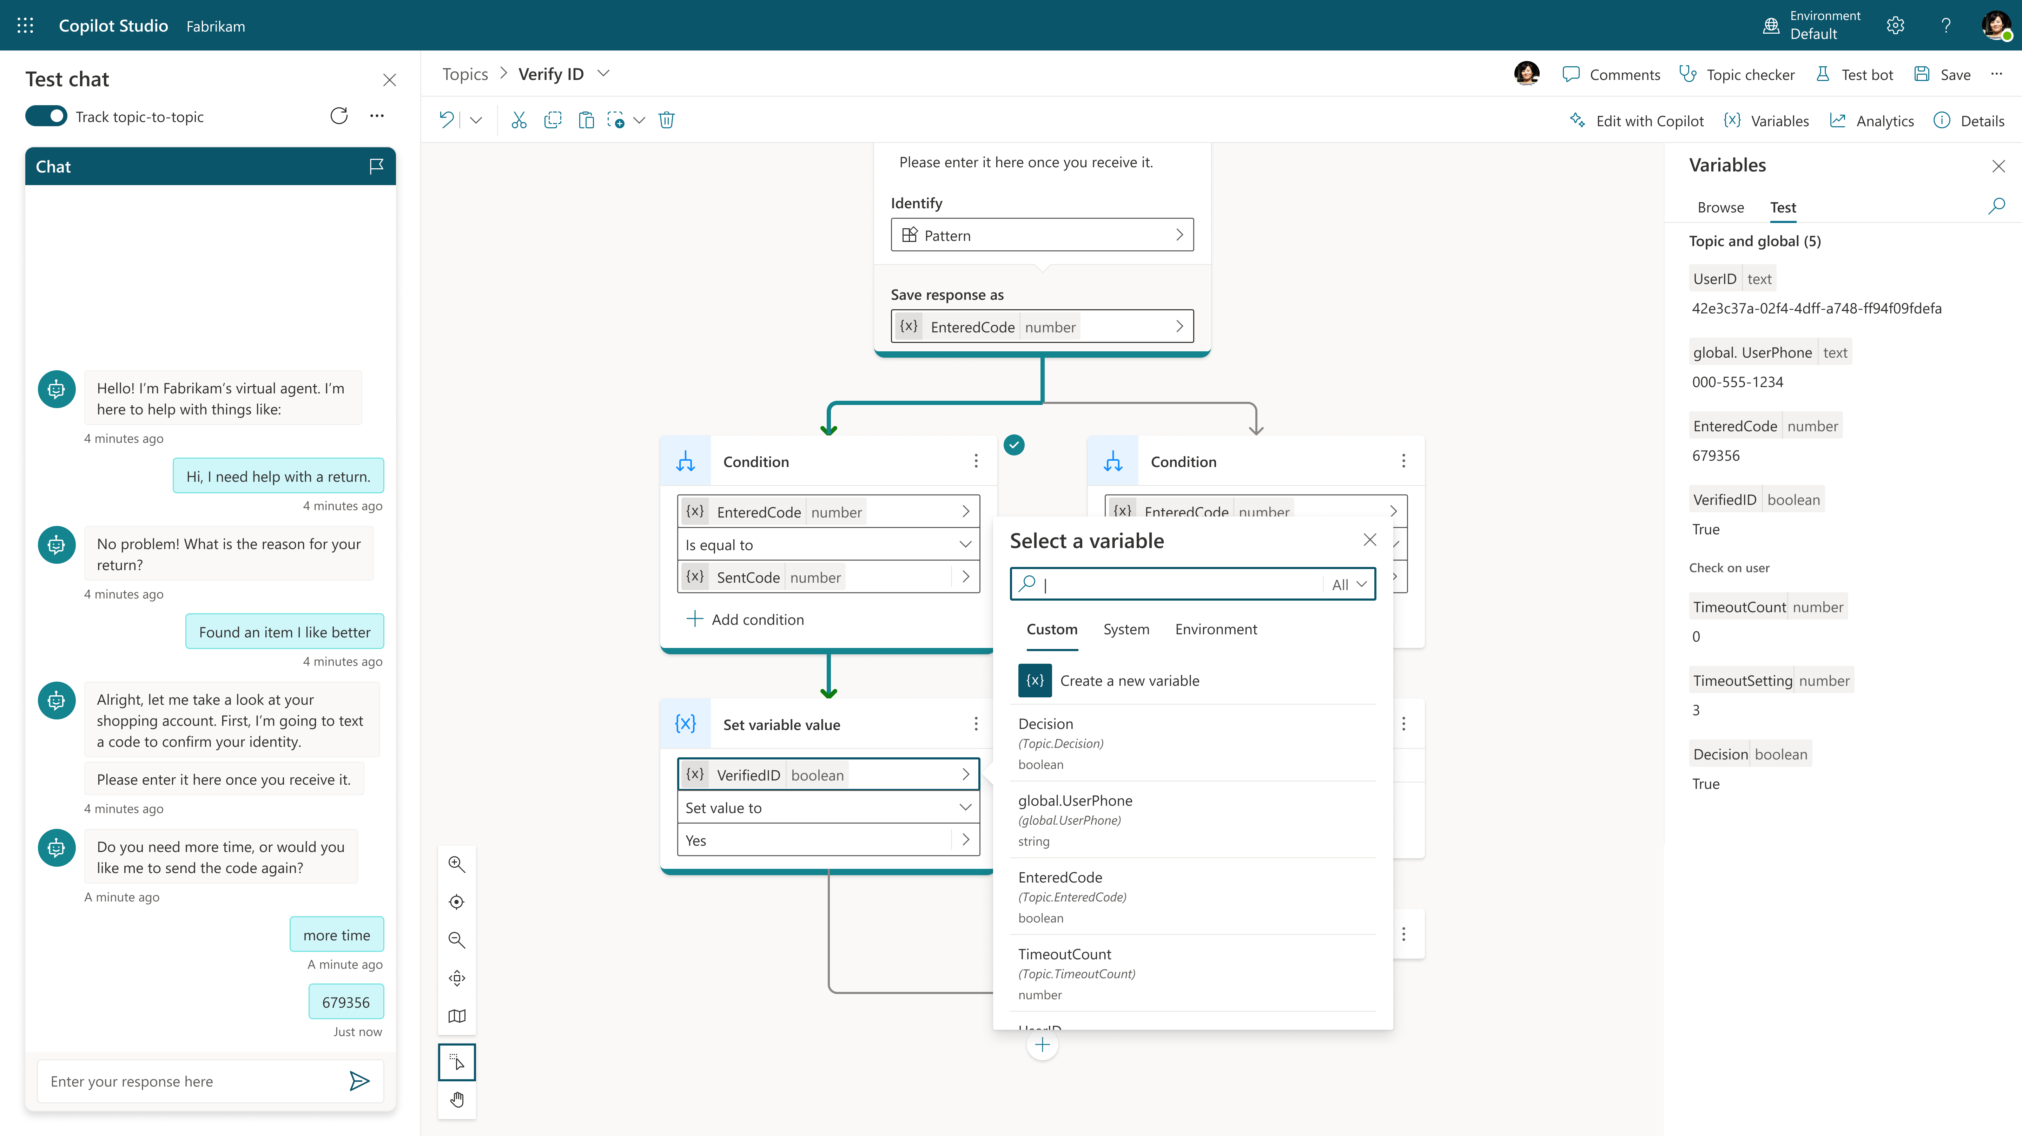
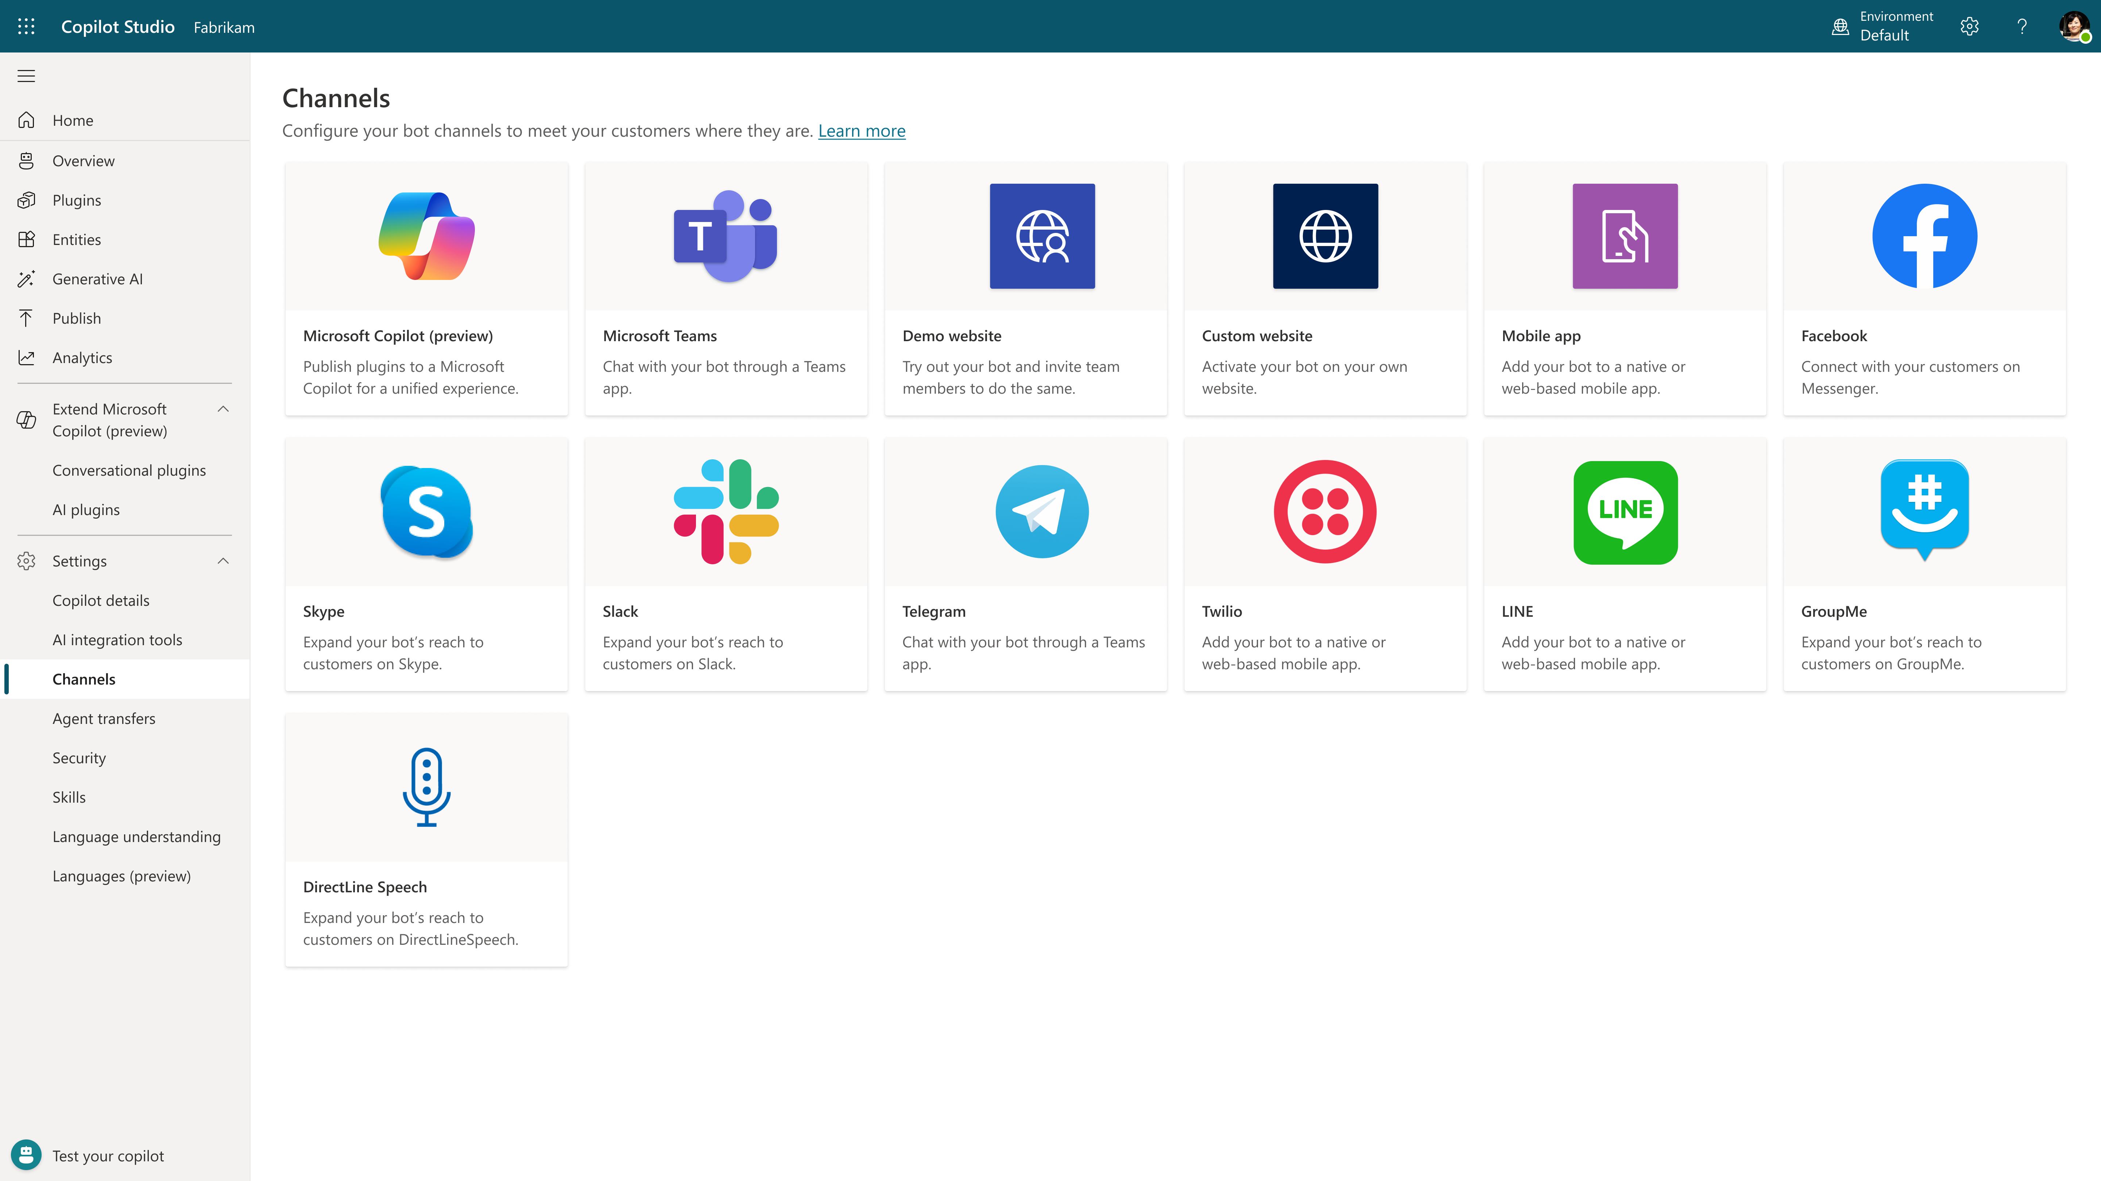
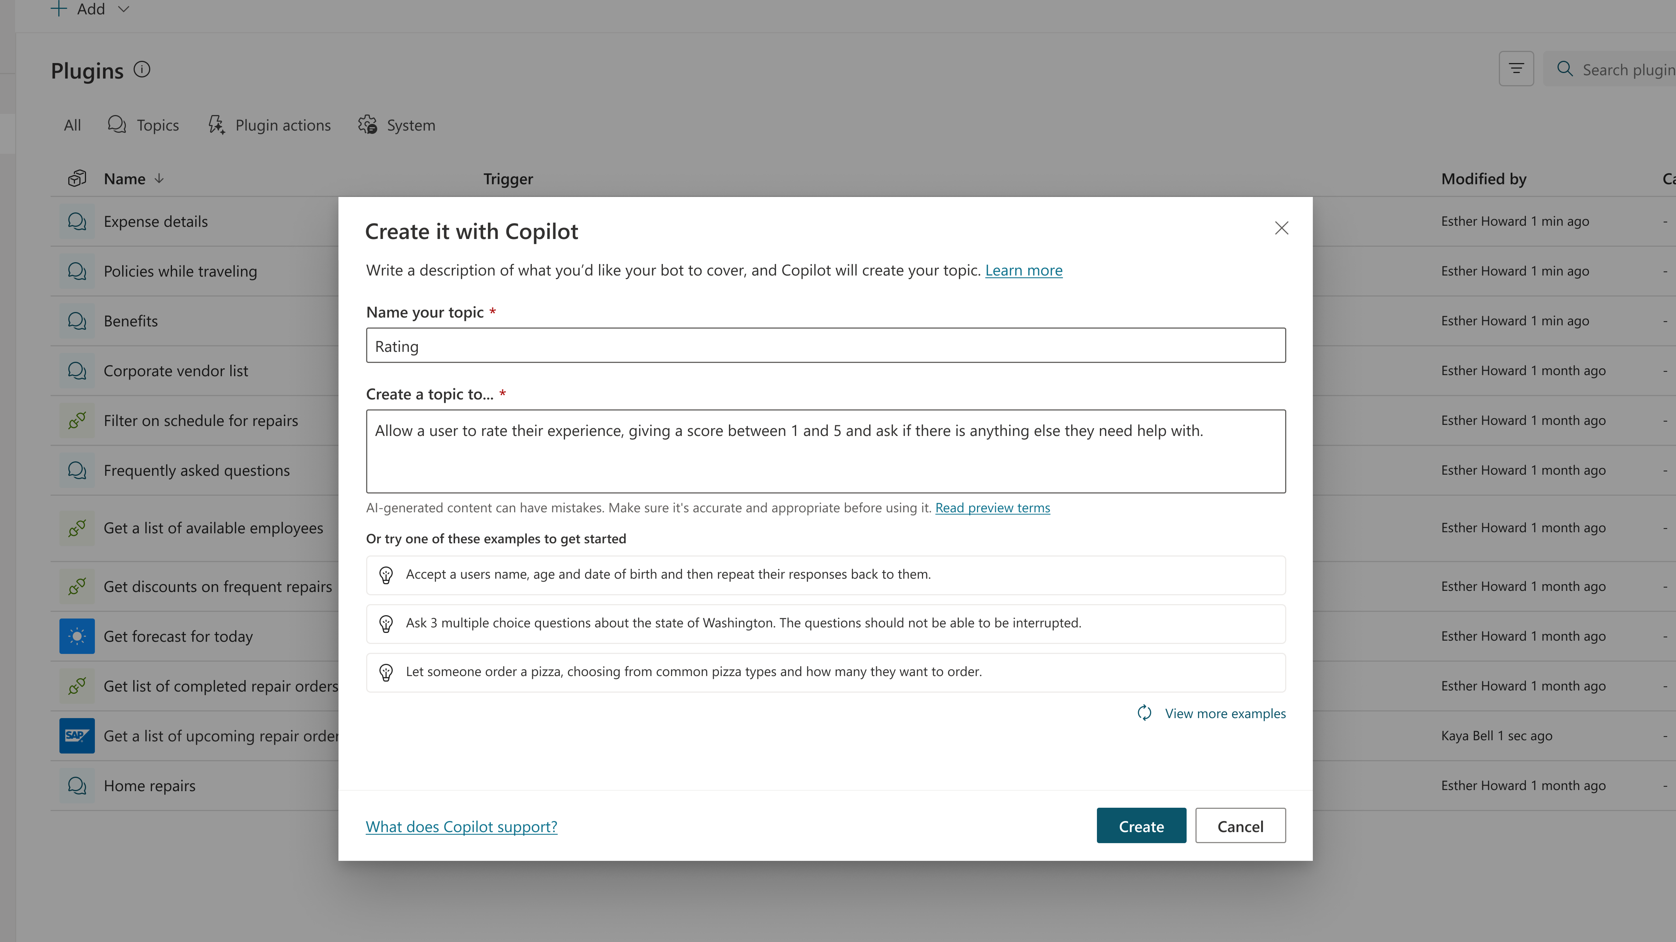
The custom copilot lifecycle
Create a copilot
Extend with Azure
Chat over knowledge
Copilot Studio
Monitor and Improve
Your copilot, your way
Create specific topics
Multiple channels
Actions & Plugins

Slide 6
Create a copilot that can chat over your data

Slide 7
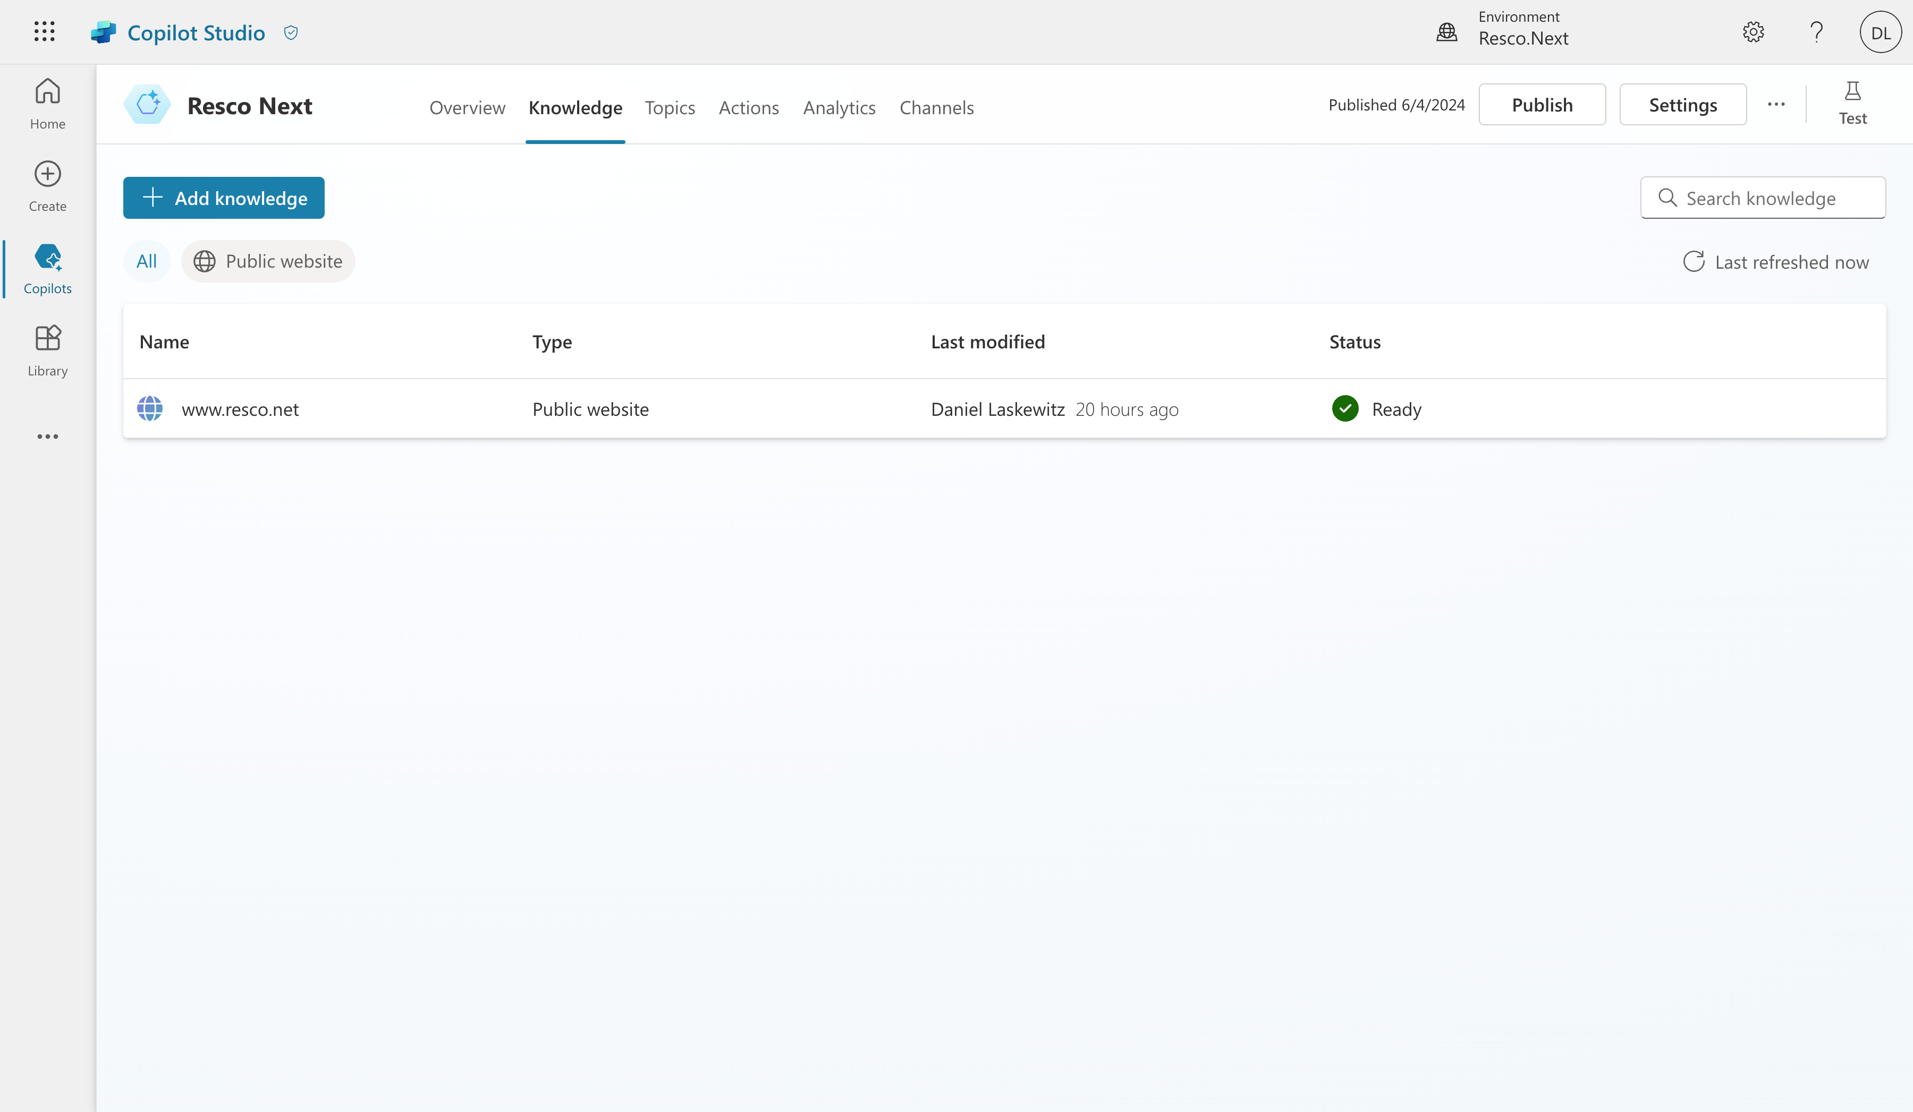
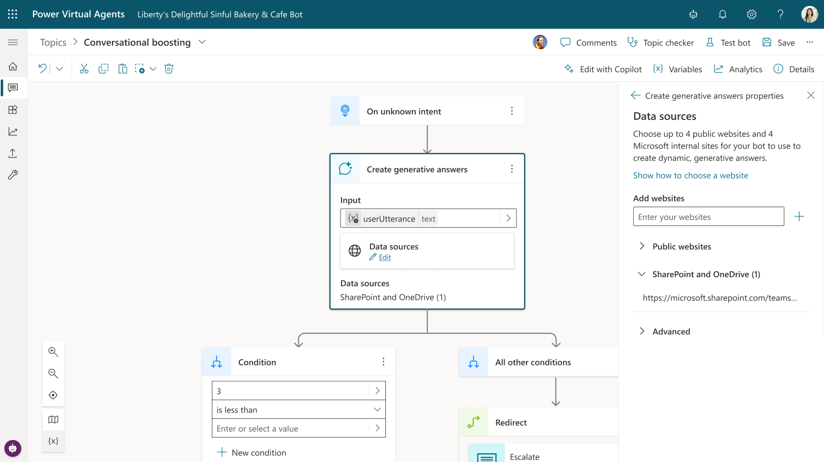
Generative Answers
Enable multi-turn chat over your own internal and external knowledge sources and sites with generative answers
Copilots can answer thousands of questions out of the box in seconds
You can even pull data from an API or other backend system and enable generative chat over it
Try now at aka.ms/copilotstudio

Slide 8
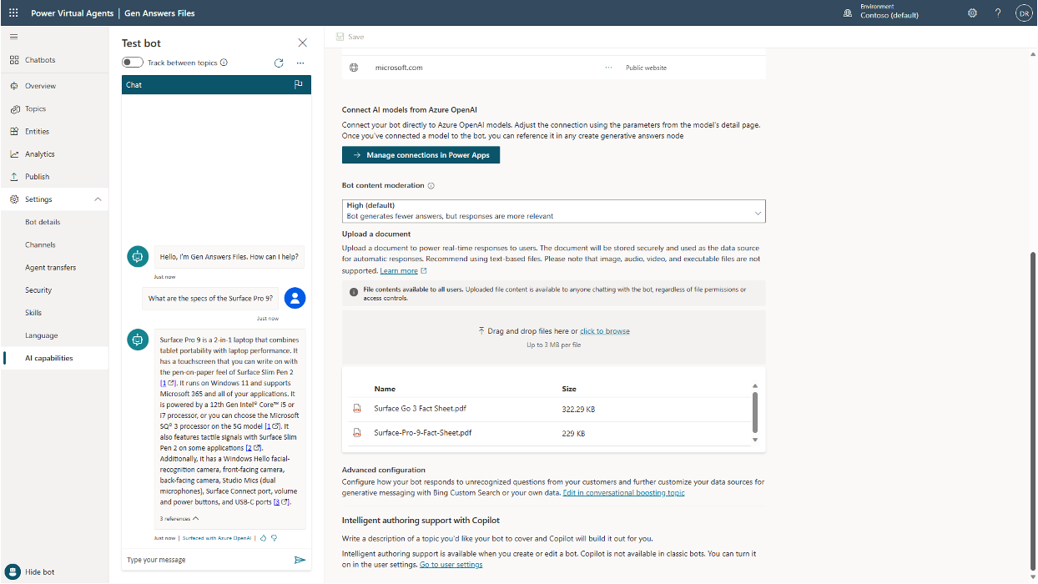
File Upload for Generative Answers
Upload files for use with Generative Answers to Dataverse securely
Text-based documents hosted and indexed for use with Gen Answers
Support for numerous formats such as Word, Excel, PowerPoint, PDF, TXT, HTML, CSV, XML, EPUB, RTF, JSON, and many more
Node-level control
Try now at aka.ms/copilotstudio

Slide 9
DEMO: Create a copilot that can chat over your data
Notes:
Create a copilot with the Safe Travels template copilot.
Ask the question:
“What is the US Visa Policy?”
If you want to make it more specific to your audience, add a website through the knowledge part for travel in the region where you are. For instance, when doing the presentation in the EU, use an EU travel site and ask a question about something local.
NOTE: always test the question well beforehand. Some websites aren’t as well indexed as others, which can ruin your demo.

Slide 10
Generative Actions

Slide 11
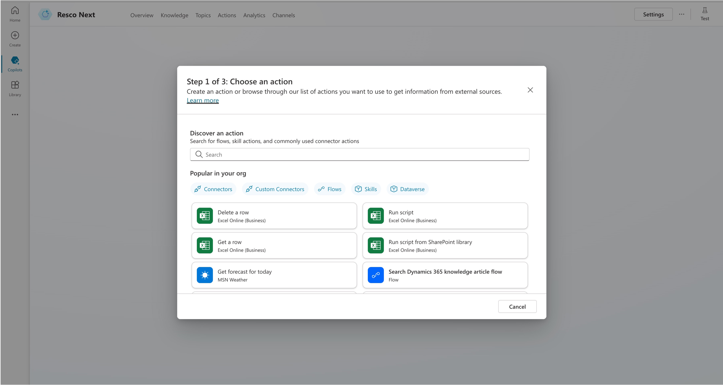
Actions and Plugins
Add plugins to allow your bot to converse over your APIs
Add plugins based on 1000+ pre-built connectors or create ones for your custom APIs. Or combine them together in complex workflows.
Conversation is automatically generated to fill in required inputs to run plugins.
Call a plugin explicitly from a Topic or use the new Generative Actions public preview to let your bot choose when to call a plugin.

Slide 12
DEMO: Create a specific topic with copilot in Copilot Studio
Notes:
Create a topic with the AI Prompt “Travel Plans”.
Ask the following question at the end: “Can you help me build a travel plan?”
Use the location of your presentation as the destination and use 3 as the number of activities.

Slide 13
Resources
Try Microsoft Copilot Studio
Copilot Studio Snippets
aka.ms/trycopilotstudio
aka.ms/copilot-studio-snippets
Prompt Library
Implementation Guide
aka.ms/ai-builder-prompts
https://aka.ms/copilotstudioimplementationguide
AI Builder prompting guide
aka.ms/promptguide

